Slide 1
Callset Evaluation
GATK Best Practices for Variant Discovery
Comparing statistics between your callset and external resources
Notes:
https://software.broadinstitute.org/gatk/documentation/article.php?id=6308
Decide if you want to proceed with this callset or revisit your previous work.
----
To this point, you’ve produced a variant callset in the form of a VCF file. Question: Ready for analyses? Run some QC first.
Complex problem. If you knew the exact truth of what variants you have in your samples, you wouldn’t be running variant discovery on your data.
Needs to be similar ENOUGH to be validated but also novel enough to be interesting
What we’ll be discussing is a method where you compare your variant callset against another set
((((that is similar in data, equipment, etc))))
called a truth set or gold standard.
-

Slide 2
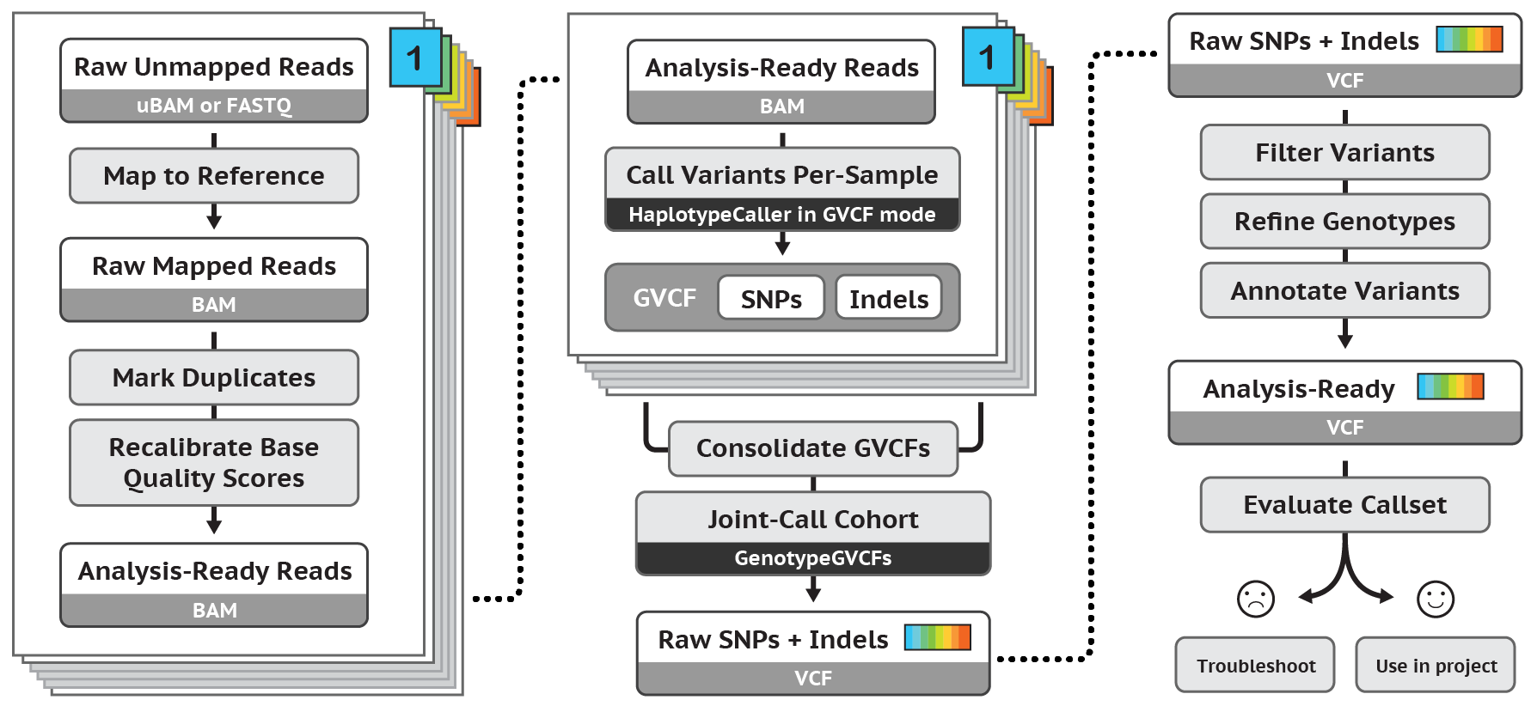
Best Practices for Germline SNP & INDEL Discovery
Notes:
We talked about how automating is good.
Can automate pipelines for everything before (mapping, mark duplicates, etc.), but not all of this part can be automated.
Sometimes, more art than science.
------------------------
*** update? -> should point to / highlight “Evaluate Callset “

Slide 3
What do callset evaluation methods aim to determine?
IDEAL
OKAY
TERRIBLE
Your variant calls perfectly match the underlying biological truth
You found many real variants and called few false positives
You didn’t find any real variants and only called artifacts!
Where are you on this spectrum?
(not veracity of individual variant calls)
Notes:
We perform callset evaluation in order to find out where our callset falls on this spectrum (ideal -> terrible).
This is for CALLSET AS A WHOLE, not individual variants. Do this to guide your further refinement, filtering, and any subsequent validation.

Slide 4
How do I figure out how good/bad my callset is?
Compare key statistics from callset and truth set stats
Guiding principle: divergence is indicative of error
Notes:
Each vcf you have contains a whole bunch of specifications that GATK tools can show.
Will go over these metrics in later slides
With these specs, you can compare your callset against a data set you consider to be true (i.e. a truth set)
some caveats: ex) cohort sizes, if bigger, then # of SNPs and indels are going to be bigger
you want it to match but you won't find exact matches so you need to adjust to it.

Slide 5
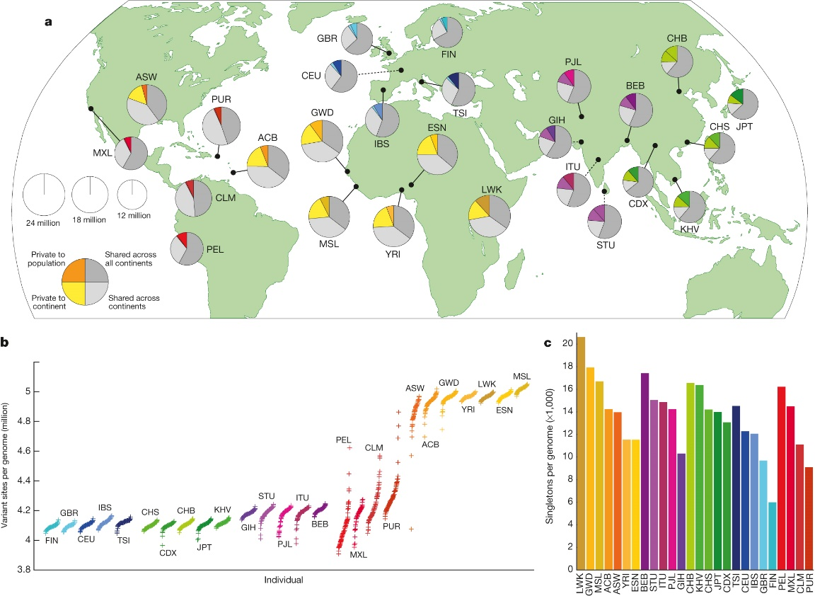
Key assumption: truth set is representative / comparable
Important to match dataset properties!
Population ethnicity (European, African, etc.)
Sequencing / exp. design (WGS vs. WES)
Cohort size
Not easy! You might need to use sub-cohorts (of both sets) to match all three.
http://www.nature.com/nature/journal/v526/n7571/full/nature15393.html
Notes:
Callset Evaluation depends on having a good representative truth set to compare to.
Match the populations: It has been shown that cohorts of different geographic ancestry have different patterns/amounts of variants. It wouldn’t make sense to use a European population for your truth set when looking at African data for example
Match the sequencing technique: Your truth set should be whole-genome sequencing or whole-exome sequencing in the same way that your callset was sequenced, provided that you are using sequenced data for a truth set. Whole genome sequencing data will call variants in intergenic regions, whereas whole exome data will not. Additionally, whole exome data is more likely to call variants at the edges of their reads, resulting in possible calls at the beginning or end of an exome.
Family-based project – will look different from non-family based
Cohort sizes: 100 vs 100,000 ; statistics will be different so can’t compare them
Graph: The average number of singletons per genome (from 1000 Genomes Project)
Need to match these as best we can to compare statistics
(last point)

Slide 6
Commonly used truth sets
dbSNP All previously reported variation (lots of junk!)
ExAC and GnomAD Extensive catalog of human variation built by aggregating results from many studies
HapMap Highly validated common human variants
OMNI Common variation validated by array
NIST’s Genomes in a Bottle, or Illumina’s Platinum Genomes high confidence callsets from a handful of common benchmarking samples
Notes:
A truth set is a set of data that you trust to serve as a standard of comparison. The following are some examples
dbSNP: a not-so-good truth set mainly used as a sanity check, since it is not quality checked before variants are included ; cannot delete bad sets (?)
ExAC – entire catalog of human variation ;; ExAC contains data about exomes and gnomAD contains ExAC + whole genomes ; graph about ExAC on next slide
HapMap, OMNI, & NIST: great public resources
HapMap – Whole genomes – relatively global populations
OMNI – array validation of common SNPs
NIST: National Institute of Standards and Technology
Multi-caller and multi-technology on a handful of samples
‘Genomes in a Bottle’ is mostly for method developers to use to validate their methods.
--------------------------
ExAC - Exome Aggregation Consortium
gnomAD - Genome Aggregation Database

Slide 7
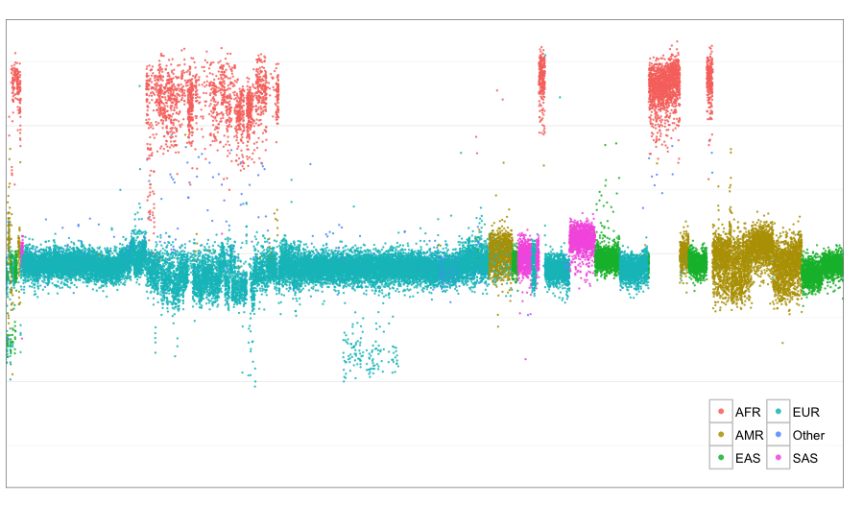
Ethnicity affects many variant call metrics
SNP
count
From a Large Exome cohort (ExAC)
SIGMA
TAT
24K
21K
18K
T2D-GENES GoT2D
Bipolar
NFBC
ATV
1000G
BUP
ESP
Ottawa
SCZ
Monkol Lek, 2014
Notes:
The x-axis is individuals
ExAC dataset – exome aggregation consortium,
data from many projects,
150k samples
This graph: grouped by project, colored by ethnicity, each dot is a sample
- explain the groupings (projects):
- 1000 genomes project - population-wide study
- T2D -- Type 2 diabetes
ExAC is available to remove common variations
SNP count is a metric you’ll compare (one of the specs from a prior slide), and you can see that snp count is higher for certain ethnicities than others.
Aside: You can infer the ethnicity of your samples after the fact (((as long as you don’t have errors in your callset that yield false positives)))
Most obvious is the set of African samples—many more SNPs than the human reference.
(Notice that african population higher? -> next slide)

Slide 8
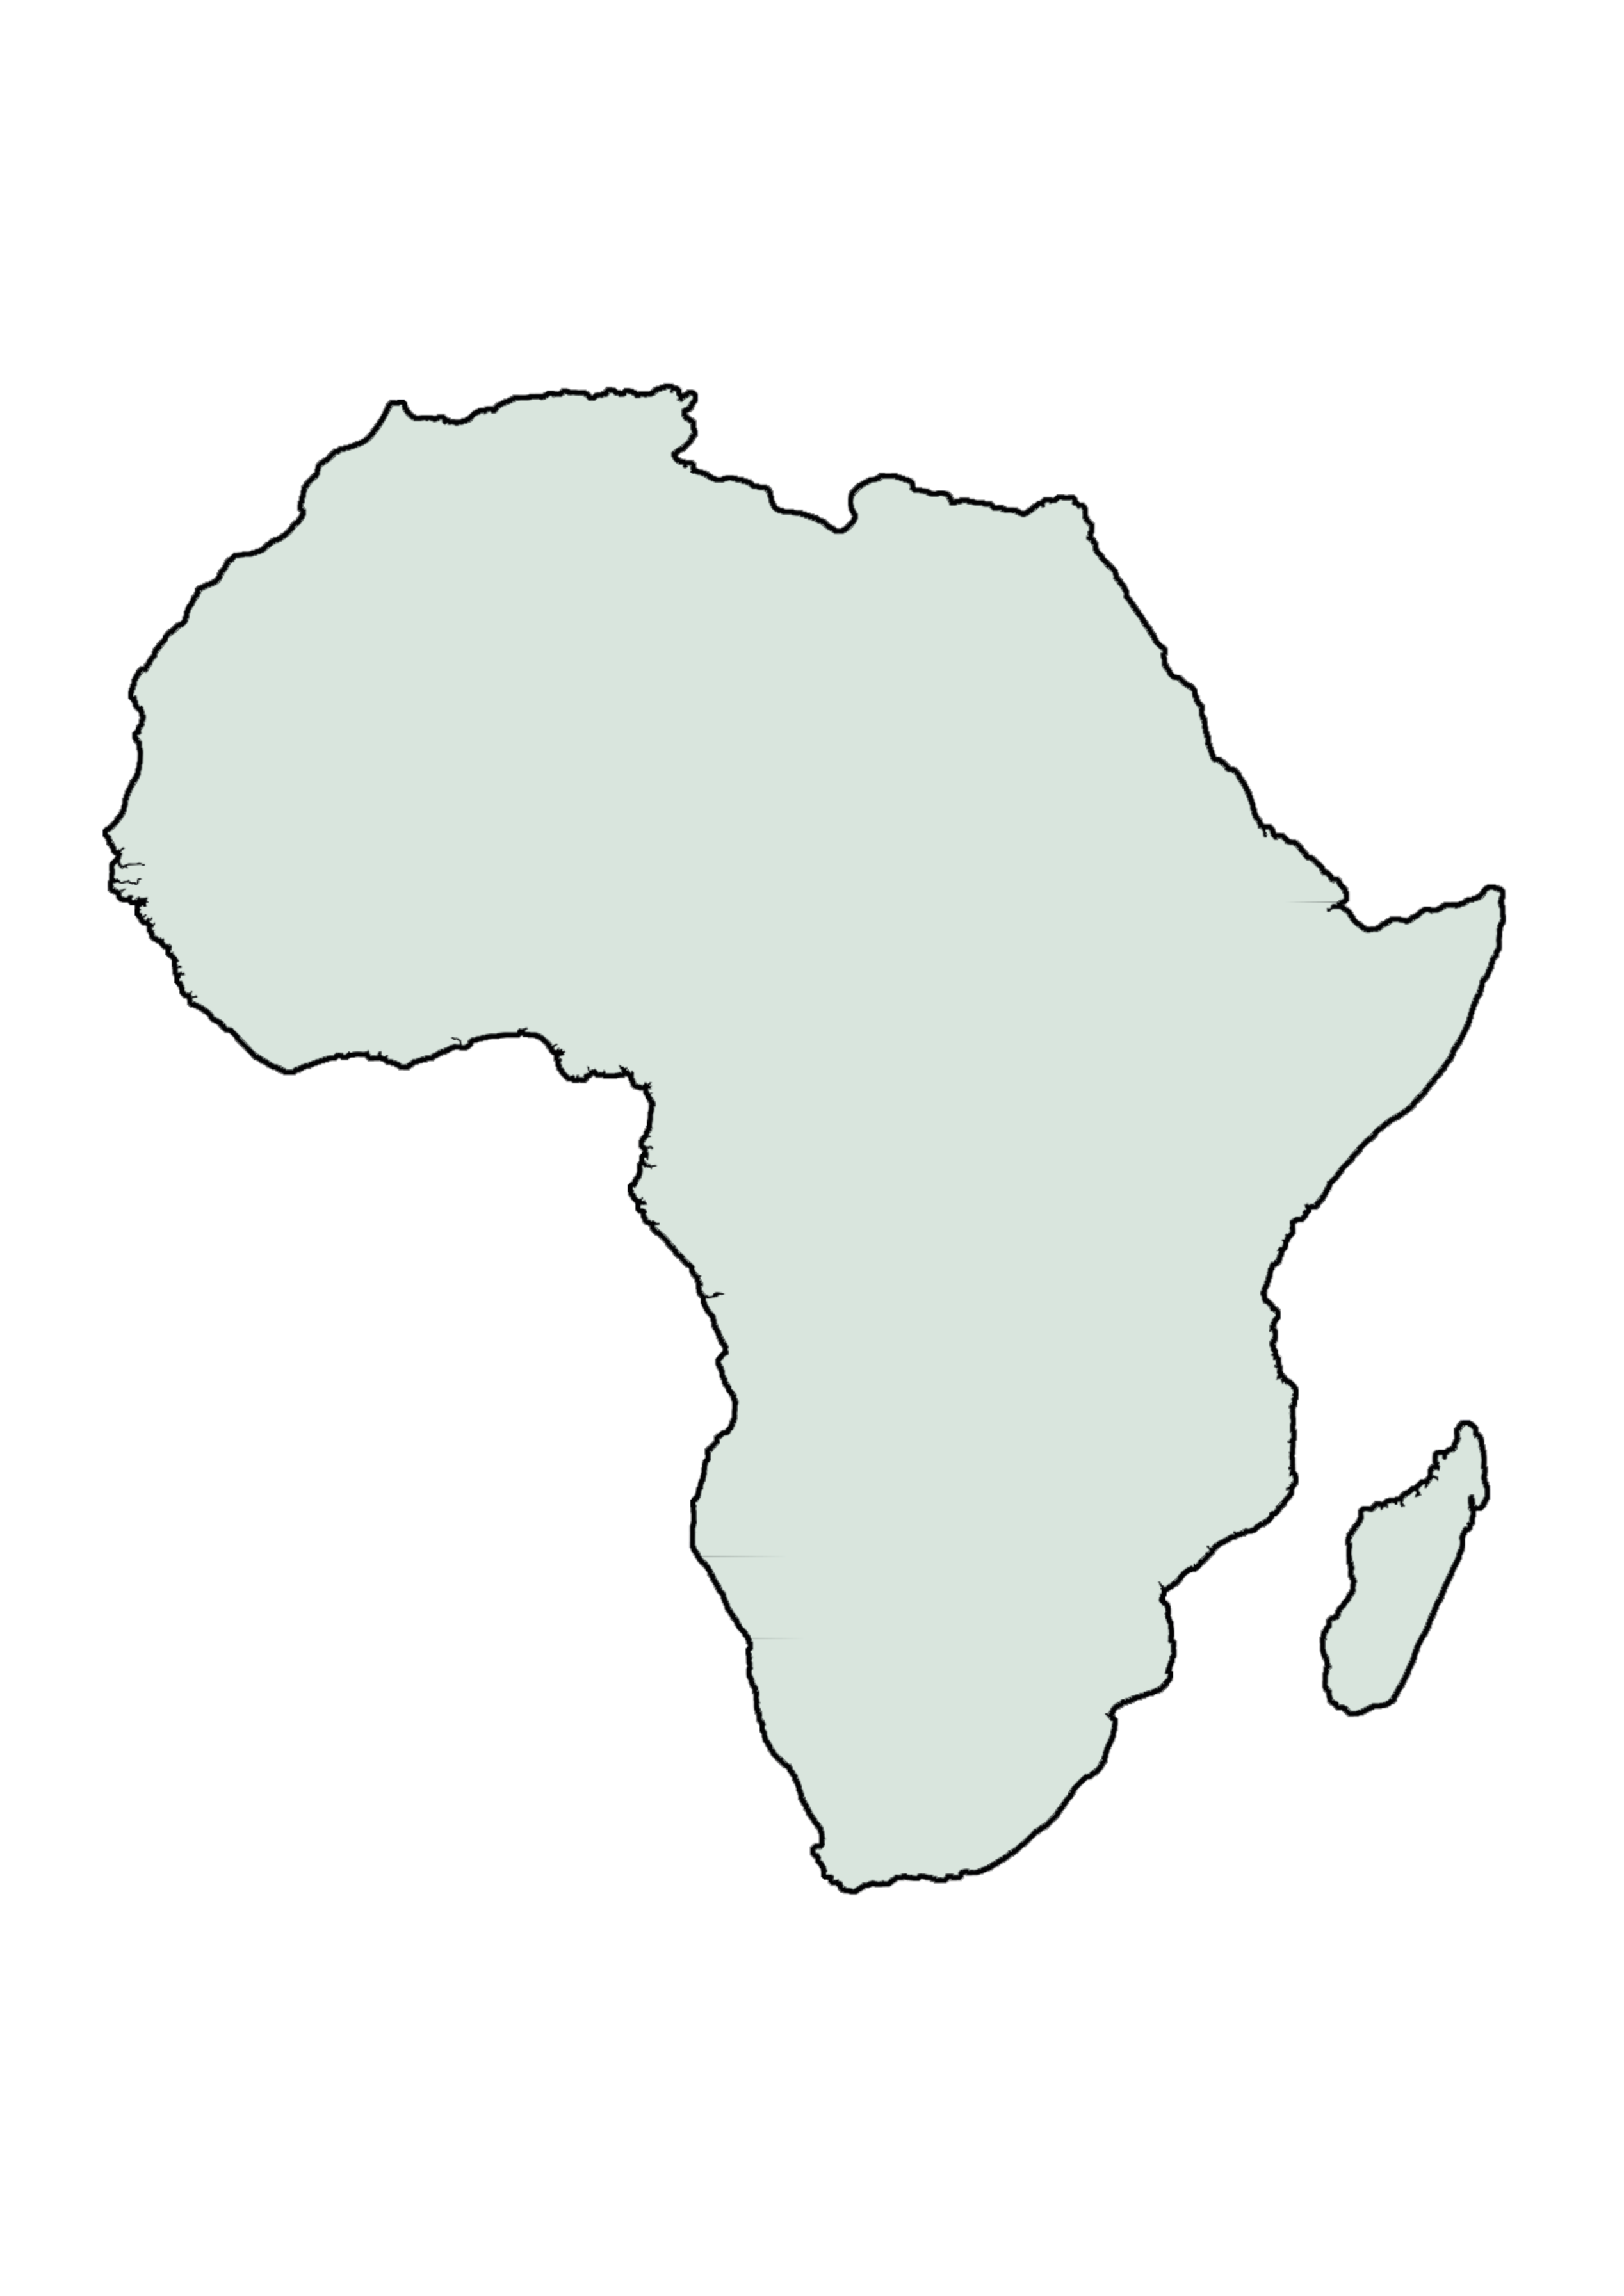





Older populations tend to display more heterogeneity
Notes:
One of the reasons we see more SNPs in African samples is that the older population in Africa was diverse and displays more heterogeneity, in contrast to younger populations that exhibit the Founder Effect:
the reduced genetic diversity that results when a population is descended from a small number of colonizing ancestors
(Reference was made with europeans)
---------
In population genetics, the founder effect is the loss of genetic variation that occurs when a new population is established by a very small number of individuals from a larger population

Slide 9
Recommended metrics for callset evaluation
Number of Indels & SNPs
TiTv Ratio
Indel Ratio
Genotype Concordance
Notes:
For callset evalutation
* name each of these, and say we’ll be going into detail in the next slides.
We will get to how to find these metrics in a minute, but first let’s discuss some metrics that are useful to examine. *The ones listed here should be considered the minimum*; if you have additional metrics you’d like to examine, as well as the data for them and an understanding of how those additional metrics are meaningful, then by all means, use them!
(((
Define:
- Indels: a shortening of insertions and deletions.
SNPs: single nucleotide polymorphisms
TiTv Ratio: The ratio of transition (Ti) to transversion (Tv) mutations
Indel Ratio: The ratio of insertions to deletions
% concordance: the percentage of variants in your samples that match (are concordant with) variants in your truth set.
)))

Slide 10
Number of Indels & SNPs
Variants = Indels + SNPs
Useful for order-of-magnitude sanity check
Vary by size and diversity of cohort
Sequencing Type | # of Variants (in 1 sample)
WGS | ~4.4 M
WES | ~21 k
Notes:
Table:
# of variants for a single sample;
Whole genome sequencing vs whole exome sequencing
(This is for humans)
# of variants. Sanity check - ball park
more samples in a cohort => overall greater # of variants

Slide 11
Indel Ratio
Ratio of insertions to deletions
Varies by allele frequency: common (”known”) vs. rare (“novel”)
Variant prevalence | Indel Ratio
Common | ~1
Rare | 0.2-0.5
Notes:
Indel - Ratio of insertions to deletions
For Indels: Deletions are more likely to occur than insertions.
In Common variants, expect indel ratio to be ~1.
in rare variations, deletions are more prevalent
- Hasn’t had time to undergo selective pressure
-----
Common variant → older (it has propagated) and not under selective pressure
Rare ->
The reference has all common variations !
Additional info:
Deletions are more prevalent in rare variations (easier for it to occur than an insertion) and
Hasn’t had time to undergo selective pressure -- or else our DNA will shrink
--------------------------
///Should we figure out how why common and rare variant association studies result in different indel ratios? Seems like that’d probably be a question asked at the talk, but I don’t know the answer.

Slide 12
TiTv Ratio (Transitions/Transversions)
Used for SNPs only
If variation were random: expect ratio of 0.5 as there are twice as many possible transversions vs transitions!
Low TiTv ratio indicates high rate of false positives
Sequencing Type | TiTv Ratio
WGS | 2.0-2.1
WES | 3.0-3.3
In Humans…
Notes:
Ratio of TiTv:
Transition (C and T ; A and G)
Transversion (other possible SNPs)
Very commonly used because low TiTv ratio clearly indicates a crappy callset – random noise
(explanation) there are 3 possible SNPs, 1 is expected but 2 are less expected (ratio of 1/2 = 0.5)
(explanation) Because of the chemical composition, you expect a base to become the similar one. (C and T ; A and G)
(explanation) This Transition is 4-6 times more likely than a transversion (4/2 or 6/2 = 2~3)
You want the numbers in the table. We expect to see the numbers in a good callset.
---------------
(((Explanation of why WES is higher than WGS:
Highly methylated CpG islands prone to C->T transitions Proportionally more CpG islands in exomes -> stronger effect
)))

Slide 13
Genotype Concordance
Most appropriate truth set is genotyping chip for same sample
% Genotype calls in callset that match calls in truth set
Unmatched variants considered false positives
Notes:
% concordance: the percentage of variants in your samples that match (are concordant with) variants in your truth set.
Most appropriate truth set:
- a genotyping chip on the same sample
- OR to use the same sample run through different callers or pre-processing methods..
Tends to be more immediately useful if you’re a developer validating your methods. But you may also want to use this if you’re evaluating callers to use on your dataset. Or if you’re tweaking parameters in your analysis and want to see which parameters are best.

Slide 14
For evaluating concordance, it is best to use truth sets generated with orthogonal methods
SEQUENCING
PROBE/ARRAY-BASED
Sanger sequencing
Other HTS technologies
GeneChip
Microarrays
Notes:
FOR CONCORDANCE:
Use the same samples with orthogonal methods since each method has different biases so it’s useful to check the concordance against different methods.
Add in samples that you DO know about.
Biases are due to artifacts of technological errors – we do base quality score recalibration but we can't eliminate all of the technological errors.
Simply re-running your samples on the same sequencer and then through the same post-sequencing analysis, then using that as your truth set, is a great way to reinforce your biases.
You want an independent measurement/analysis of your data. That way if both methods call the same set of variants, you are more likely to have a “good” callset
Sequencing Technologies:
Sanger sequencing: costly in terms of time and money, but very high accuracy
Other HTS techs: PacBio, Ion Torrent, Illumina—all have different biases b/c they sequence differently -> different error modes
Probe/Array Based Technologies:
GeneChip & microarray: Can only look at parts of the genome, but reduced cost

Slide 15
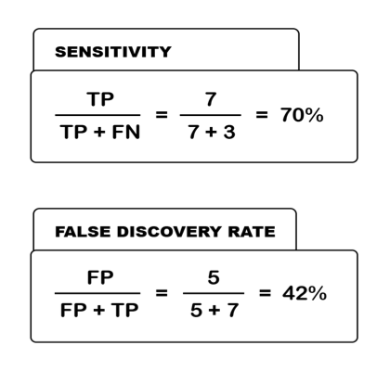
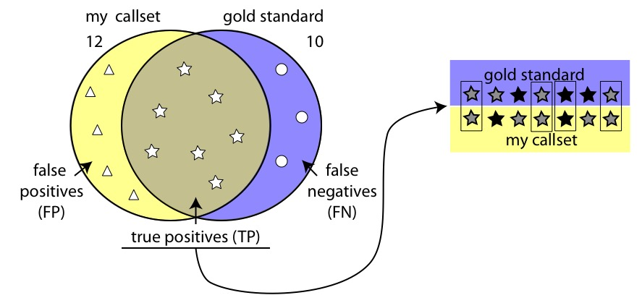
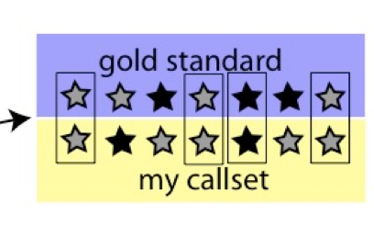
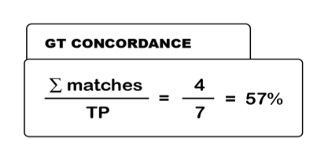
Cheat sheet of concordance metrics
Variant Concordance
Notes:
Top Venn diagram is variant concordance and bottom stars represent genotype concordance.
First approach to the Callset Evaluation should be at which sites do I have variation? Now for each of these samples for which I have variant calls on a chip, have I called them correctly? Common error in the SAMPLE-LEVEL call is to call heterozygous rather than homozygous.
-
Check concordance level against concordance level that others got.

Slide 16
So how do I get these metrics?
Variant Level Evaluation
Genotype Level Evaluation
gatk VariantEval \
-R reference.b37.fasta \
-eval callset.vcf \
--comp truthset.vcf \
-o results.eval.grp
java -jar picard.jar \
GenotypeConcordance \
CALL_VCF=input.vcf \
TRUTH_VCF=truth_set.vcf \
CALL_SAMPLE=sample_name \
TRUTH_SAMPLE=sample_in_truth \
O=gc_concordance.vcf \
Notes:
Variant level evaluation: overall quality of callset relative to a truth set.
If you have a sample-matched truth set (e.g. one that was created via orthogonal sequencing of the same samples, or from a chip on the same samples), you can also look at Genotype Concordance.
You don’t want to run all four tools. Run one variant level (more on next slide) and either GT concordance tool.
(go through one of these example calls)
NOTE: VariantEval – on GATK3 but is “coming soon” to GATK4. (another reason to use your dockers)

Slide 17
Which variant-level evaluator should I use?
GATK VariantEval
Picard CVCM
More detailed analysis
More options for stratification
Ability to compare to multiple truth sets
Best performance on very large callsets
Ability to interpret no-call as confident reference in a “confidence region”
Few options beyond the metrics discussed here
Notes:
-
GATK can parallelize
-
For GenotypeConcordance, you can use either; we don’t have a recommendation at this time.
VariantEval may be too detailed. CollectVariantCallingMetrics is for the average use case.
( stratification: indel length …)

Slide 18
Best Practices for Germline SNP & INDEL Discovery
Notes:
-
No way to automatically answer the question: “is this callset good or bad”
Have to bring it to a room and debate and talk about whether it needs this or that additional callset; this review is an important part of the process
-

